Slide 1
Lecture 27
Power in steps; two proportions

Slide 2
Review
1 What is the difference between a Type I and a Type II error?
Type I: reject H₀ when H₀ is true (a false alarm, probability α). Type II: do not reject H₀ when H₀ is false (a miss, probability β)
2 Define power.
the probability the test rejects H₀ when H₀ is false: power = P(reject H₀ | H₀ false) = 1 − β
3 What are two ways we can increase power?
a larger sample n (a smaller SE); a larger α (at the cost of more Type I errors). Also: a smaller σ, or a bigger true effect

Slide 3
Calculating power: the steps
1. set up
H₀: μ = μ₀, H_{A}, α, σ, n, and one possible truth: μ = μ_{true}
2. the SE
SE = σ / √n: the same whether H₀ is true or not
3. the cutoff, from H₀
upper-tailed: x̄* = μ₀ + Z_{1−α} × SE; lower-tailed: x̄* = μ₀ + Z_{α} × SE
4. switch to the truth
z* = (x̄* − μ_{true}) / SE: the cutoff, measured from the possible truth
5. the power
upper: P(Z ≥ z*); lower: P(Z ≤ z*); then β = 1 − power

Slide 4
Practice: harder rebar?
Steel rebar holds the concrete in bridges and buildings together, and harder bar is stronger bar. A mill’s standard bar has a mean Brinell hardness of 170 kgf/mm², normally distributed with σ = 10. The mill hopes a new heat treatment raises the mean, so an engineer will test 25 treated bars: H₀: μ = 170 vs H_{A}: μ > 170. Before testing a single bar: if the treatment really raises the mean to 175, how likely is the test to detect it? (adapted from Penn State STAT 415, Example 10.4)
σ = 10; n = 25; α = 0.05; one possible truth: μ = 175
(a) Find the SE and the cutoff x̄*.
(b) Find z* and the power. What is β?
(c) Repeat (a) and (b) with 64 bars.
(a) SE = 10 / √25 = 2; x̄* = 170 + 1.645 × 2 = 173.29
(b) z* = (173.29 − 175) / 2 ≈ −0.86; power = P(Z ≥ −0.86) = 1 − 0.1949 = 0.81; β = 0.19
(c) SE = 1.25; x̄* = 172.06; z* = −2.35; power = 1 − 0.0094 = 0.99

Slide 5
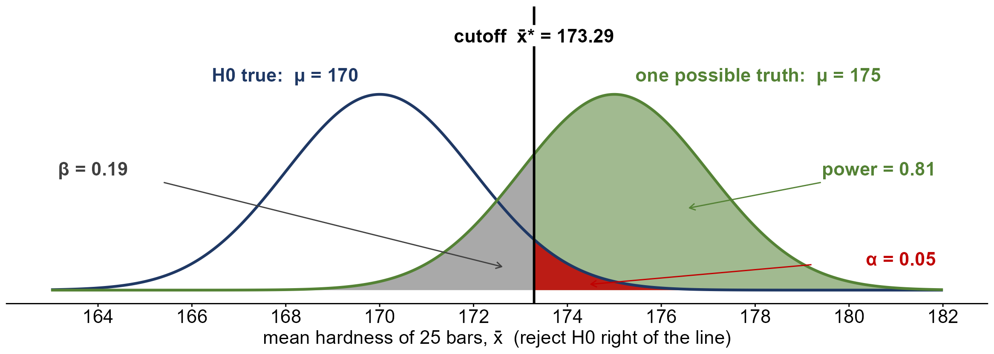
The rebar test’s power
with 25 bars, the test catches a true mean of 175 81% of the time (power) and misses it 19% (β)

Slide 6
One population or two?
1 Is the mean commute of UI students more than 20 minutes?
one sample: one population, one mean, compared with a claimed value
2 Do patients on a new drug recover more often than patients on a placebo?
two samples: two populations (drug, placebo); compare p₁ and p₂
3 Do Moscow and Pullman voters support a new levy at the same rate?
two samples: two populations (the two towns); compare p₁ and p₂

Slide 7
Two-sample tests
what they compare
the same parameter in two populations: p₁ vs p₂, or μ₁ vs μ₂
two variables
an explanatory variable (which group) and a response variable (the outcome)
the parameter
the difference: p₁ − p₂ or μ₁ − μ₂
the usual null
no difference: H₀: p₁ − p₂ = 0 (or μ₁ − μ₂ = 0)

Slide 8
Independent vs dependent samples
independent samples
one sample tells us nothing about the other: separate random samples, or randomized groups
dependent samples
each value is paired with one in the other sample: the same subjects twice, twins
why it matters
pairing changes the SE, so each design gets its own test
today
independent samples; dependent (paired) samples come on Wednesday

Slide 9
Practice: independent or dependent?
1 The blood pressure of 30 patients, before and after a new medication
dependent: the same 30 patients measured twice (matched pairs)
2 Exam scores of 40 randomly chosen students from each of two sections
independent: two separate random samples
3 Twin pairs: one twin gets a tutoring program, the other does not
dependent: each child is matched with their twin

Slide 10
Two proportions: the notation
populations 1 and 2
the two groups we compare (for example, medication A and medication B)
p₁, p₂
the population proportions with the trait: the parameters
n₁, X₁; n₂, X₂
the sample sizes, and the counts of successes in each sample
p̂₁ = X₁ / n₁, p̂₂ = X₂ / n₂
the sample proportions: p̂₁ − p̂₂ estimates p₁ − p₂

Slide 11
Two proportions: the hypotheses
H₀: p₁ = p₂
the same as H₀: p₁ − p₂ = 0: no difference between the populations
H_{A}: p₁ − p₂ > 0
upper-tailed: population 1 has the larger proportion
H_{A}: p₁ − p₂ < 0
lower-tailed: population 1 has the smaller proportion
H_{A}: p₁ − p₂ ≠ 0
two-sided: a difference in either direction

Slide 12
The sampling distribution of p̂₁ − p̂₂
the estimate
p̂₁ − p̂₂: the difference between the two sample proportions
its center
p₁ − p₂: on average, the estimate hits the true difference
its SE
√[ p₁(1 − p₁) / n₁ + p₂(1 − p₂) / n₂ ]: variances add for independent samples
its shape
approximately normal when both samples are large

Slide 13
If H₀ is true: pool the samples
one common p
if p₁ = p₂, both samples estimate the same p, so we combine them
the pooled proportion
p̂ = (X₁ + X₂) / (n₁ + n₂): all the successes over all the observations
the SE if H₀ is true
SE₀ = √[ p̂(1 − p̂)(1/n₁ + 1/n₂) ]
the test statistic
z_{obs} = (p̂₁ − p̂₂ − 0) / SE₀: z_{obs} ~ N(0, 1) if H₀ is true

Slide 14
Assumptions and the P-value
the samples
two independent random samples, one from each population
large enough
n₁p̂, n₁(1 − p̂), n₂p̂, n₂(1 − p̂) all ≥ 15, using the pooled p̂
upper or lower
H_{A}: p₁ − p₂ > 0: P(Z ≥ z_{obs} | H₀ true); < 0: P(Z ≤ z_{obs} | H₀ true)
two-sided
H_{A}: p₁ − p₂ ≠ 0: 2 × the smaller tail

Slide 15
Data: medication for hives
 | Still had hives | No hives | Total
Medication A | 20 | 180 | 200
Medication B | 12 | 188 | 200
Each row is a separate random sample of adults with hives. The response is whether a patient still had hives 30 minutes after taking the medication. (OpenStax, Example 10.8)

Slide 16
Example: medication for hives
Two medications for hives are being compared. Is there a difference between them in the proportion of adults who still have hives 30 minutes after taking the medication? (OpenStax, Example 10.8)
A: 20 of 200; B: 12 of 200; α = 0.01
(a) State H₀ and H_{A}. Which tail?
(b) Find p̂_{A}, p̂_{B} and the pooled p̂. Are the samples large enough?
(c) Find SE₀ and z_{obs}.
(d) Find the P-value. What is the decision?
(a) H₀: p_{A} − p_{B} = 0 H_{A}: p_{A} − p_{B} ≠ 0 (two-sided)
(b) 0.10, 0.06; p̂ = 32 / 400 = 0.08; smallest count 200(0.08) = 16 ≥ 15
(c) SE₀ = √[0.08(0.92)(1/200 + 1/200)] = 0.02713; z_{obs} = 0.04 / 0.02713 = 1.47
(d) 2(1 − 0.9292) = 0.1416 > 0.01: do not reject H₀

Slide 17
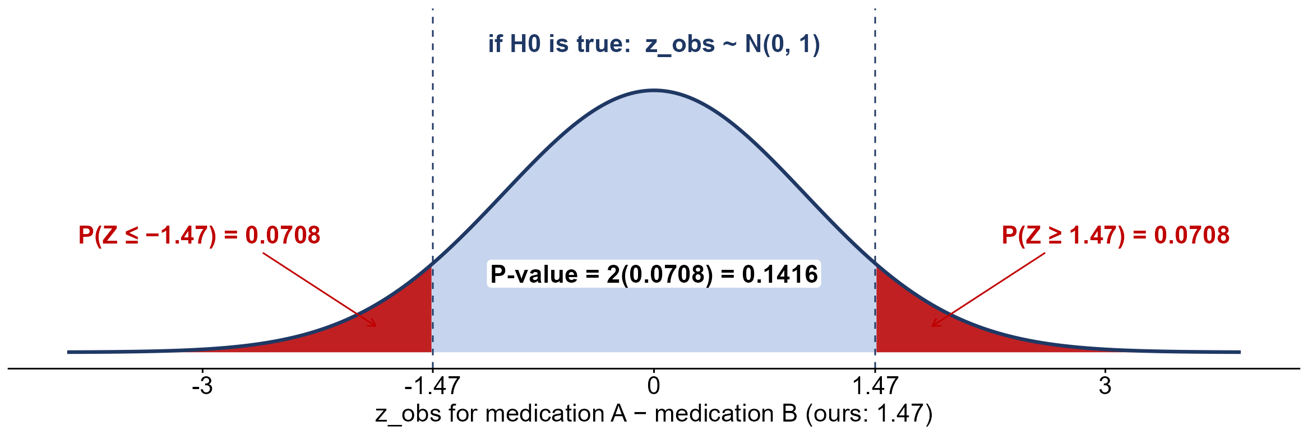
The hives P-value
0.1416 > 0.01: no evidence of a difference between the medications

Slide 18
Practice: seat belts
A researcher believes that women are less likely than men to go without a seat belt. A random sample of U.S. adults was asked whether they wear one. Is the proportion of women who do not wear seat belts lower than the proportion of men? (OpenStax, Example 10.9)
Do not wear one: women 156 of 2,169; men 183 of 2,231; α = 0.01
(a) State H₀ and H_{A}. Which tail?
(b) Find p̂_{W}, p̂_{M} and the pooled p̂. Are the samples large enough?
(c) Find SE₀ and z_{obs}.
(d) Find the P-value. What is the decision?
(a) H₀: p_{W} − p_{M} = 0 H_{A}: p_{W} − p_{M} < 0 (lower-tailed)
(b) 0.0719, 0.0820; p̂ = 339 / 4400 = 0.0770; smallest count 2169(0.0770) ≈ 167 ≥ 15
(c) SE₀ = √[0.077(0.923)(1/2169 + 1/2231)] = 0.0080; z_{obs} = −0.0101 / 0.0080 = −1.26
(d) P(Z ≤ −1.26) = 0.1038 > 0.01: do not reject H₀

Slide 19
Practice: electric vehicles
A marketing firm claims that younger adults are more likely than older adults to own an electric vehicle. A random sample of U.S. adults found how many in each age group own one: younger means 34 or under, older means 35 or over. (OpenStax, Example 10.10)
Own an EV: younger 135 of 1,343; older 12 of 232; α = 0.05
(a) State H₀ and H_{A}. Which tail?
(b) Find p̂_{Y}, p̂_{O} and the pooled p̂. Are the samples large enough?
(c) Find SE₀ and z_{obs}.
(d) Find the P-value. What is the decision?
(a) H₀: p_{Y} − p_{O} = 0 H_{A}: p_{Y} − p_{O} > 0 (upper-tailed)
(b) 0.1005, 0.0517; p̂ = 147 / 1575 = 0.0933; smallest count 232(0.0933) ≈ 21.6 ≥ 15
(c) SE₀ = √[0.0933(0.9067)(1/1343 + 1/232)] = 0.0207; z_{obs} = 0.0488 / 0.0207 = 2.36
(d) P(Z ≥ 2.36) = 1 − 0.9909 = 0.0091 < 0.05: reject H₀

